Slide 1
TrackCycle
Energy Efficient GPS
Notes:
Both

Slide 2
Project sponsors
Dr. Mossé - sponsor
Gavin Heinrichs-Majetich - owner/creator
Notes:
Lucas

Slide 3


What is TrackCycle?
Mobile app targeting Android OS at API level 31
Tracks bicycle trips with path estimation
Minimize power consumption through duty-cycling
Only turn on the GPS when necessary
Maintain high level of accuracy
Notes:
Lucas

Slide 4
Duty-cycling
Triggered by using a combination of on-device inertial measurement unit (IMU) and magnetometer sensors
Detects when riders have veered off of a straight, estimable path
GPS is off while riding in a straight line, turns back on when a rider changes directions
Less GPS usage means less power consumption, but also less accuracy
Find the fine line between energy efficiency and accuracy
Notes:
Lucas

Slide 5
Setbacks
Neither of us had Android phones.
Matt’s mom to the rescue!
Jailbreak old Androids?
Neither of us had experience with Android Studio or Kotlin
Notes:
Matt

Slide 6
Sprint 1
Learn how to use Android Studio and Kotlin
Gather data from test rides
Side by side tests with duty-cycling and GPS always on
Compare path estimation
Notes:
Lucas

Slide 7
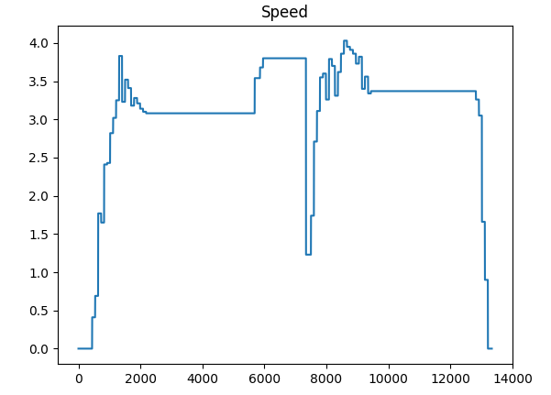
Data - Statistics
Notes:
Matt

Slide 8
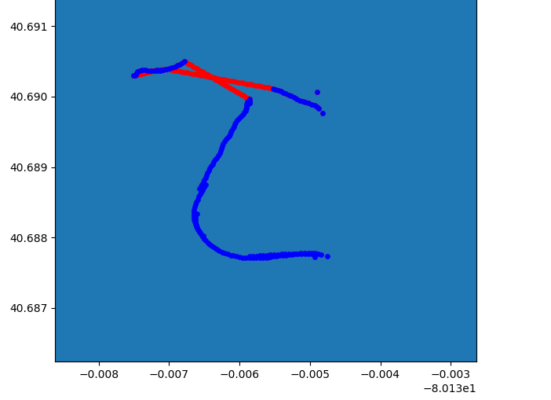
Data - Map
Notes:
Matt

Slide 9
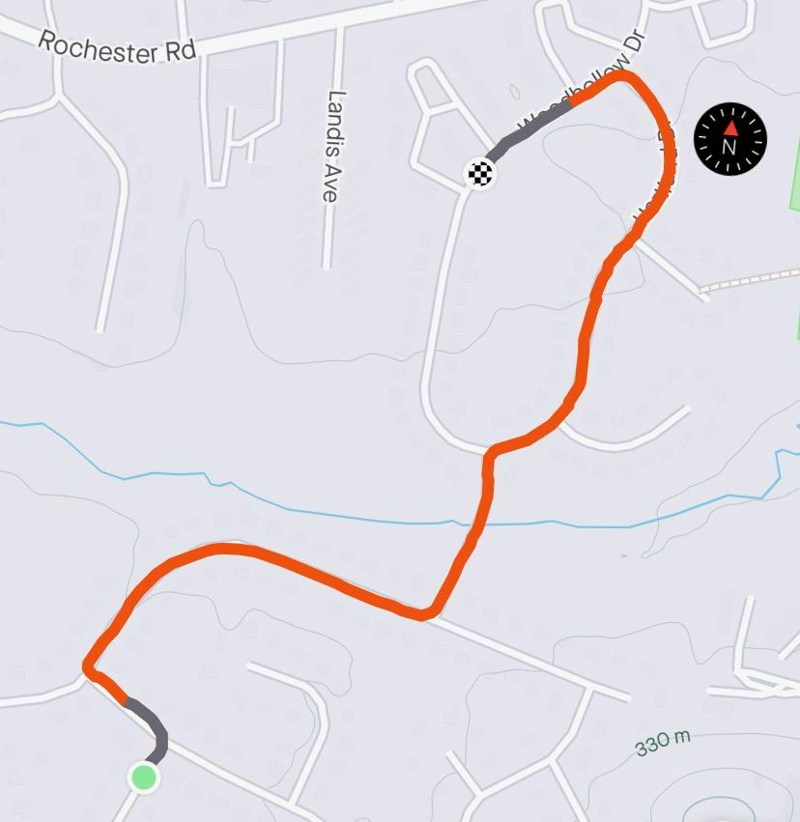
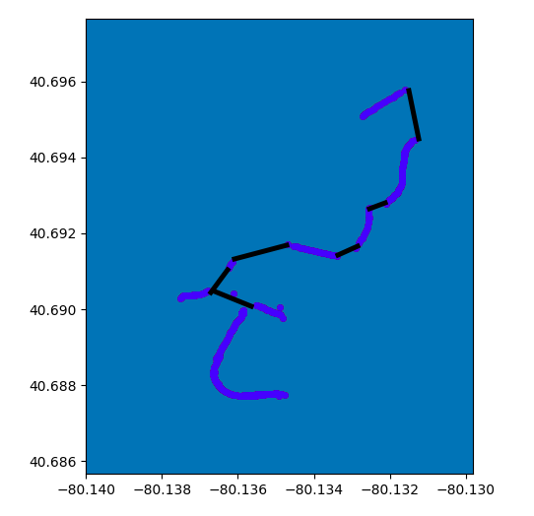
Map comparison
Strava
TrackCycle
Notes:
Matt

Slide 10
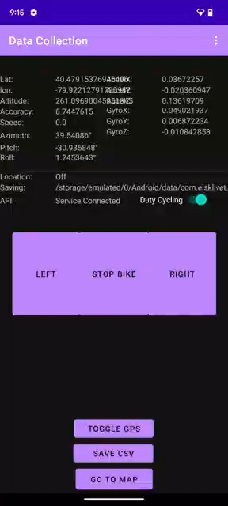
Live Demo
Notes:
Matt

Slide 11
Remaining Goals
Calculate and reduce error
Improve duty-cycling thresholds
Develop a user-friendly UI
Demonstrate a working product
Notes:
Lucas

Slide 12
Thank You!
Notes:
Both

